Slide 1





EXPLANABLE AI FOR GENERATIVE AI
Presented By
Zainab Jamil RP20-EE-416
Nayab Shahid RP20-EE-425
Jannat Khurram RP20-EE-426
Noor Mohsin RP20-EE-430
Presented To
Sir Hisham Khalil

Slide 2
Table of contents
01
02
03
04
05
06
What is Generative AI?
What is Explainable AI (XAI)?
Why is Explainability Important in Generative AI?
How Does XAI Work in Generative AI?
Benefits of XAI in Generative AI
Challenges of XAI in Generative AI
07
08
09
Real-World Examples
Common XAI Techniques
Future of XAI in Generative AI

Slide 3
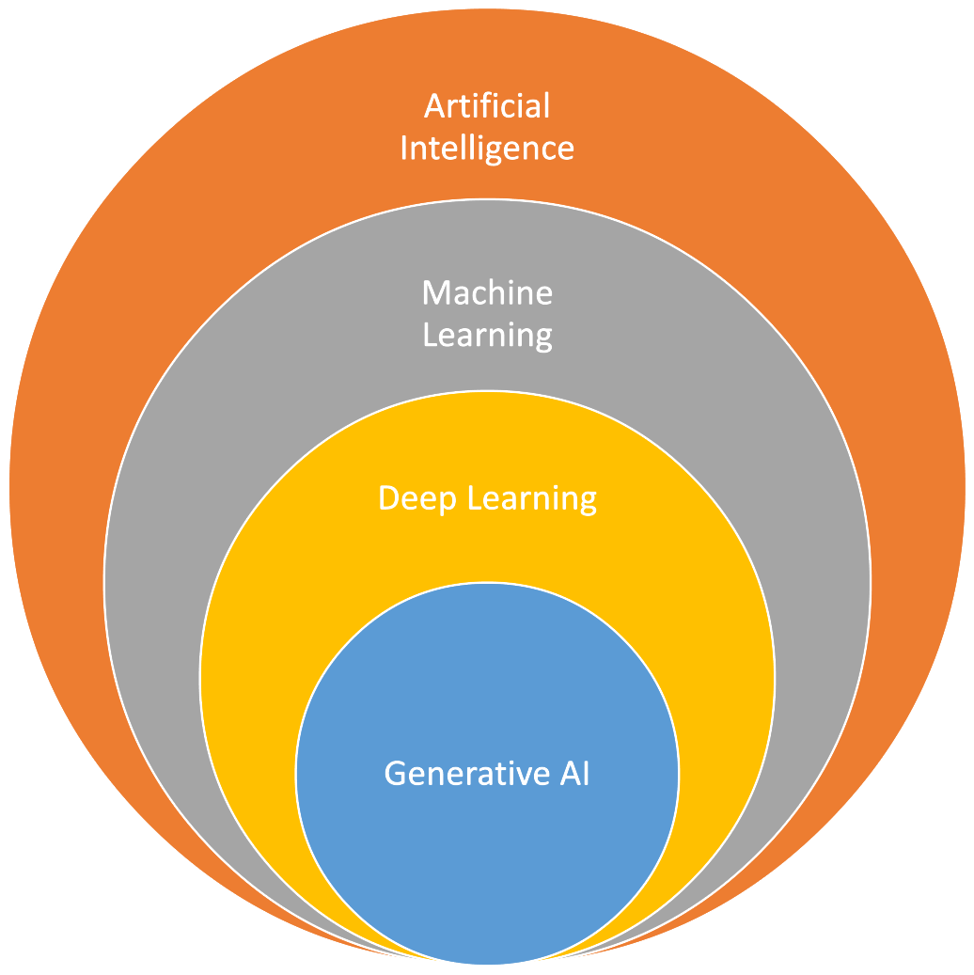
What Is Generative AI?
Generative AI creates new content, such as images, text, or music, based on patterns in existing data
Examples
Image generation, Chatbots, Text-to-Speech

Slide 4
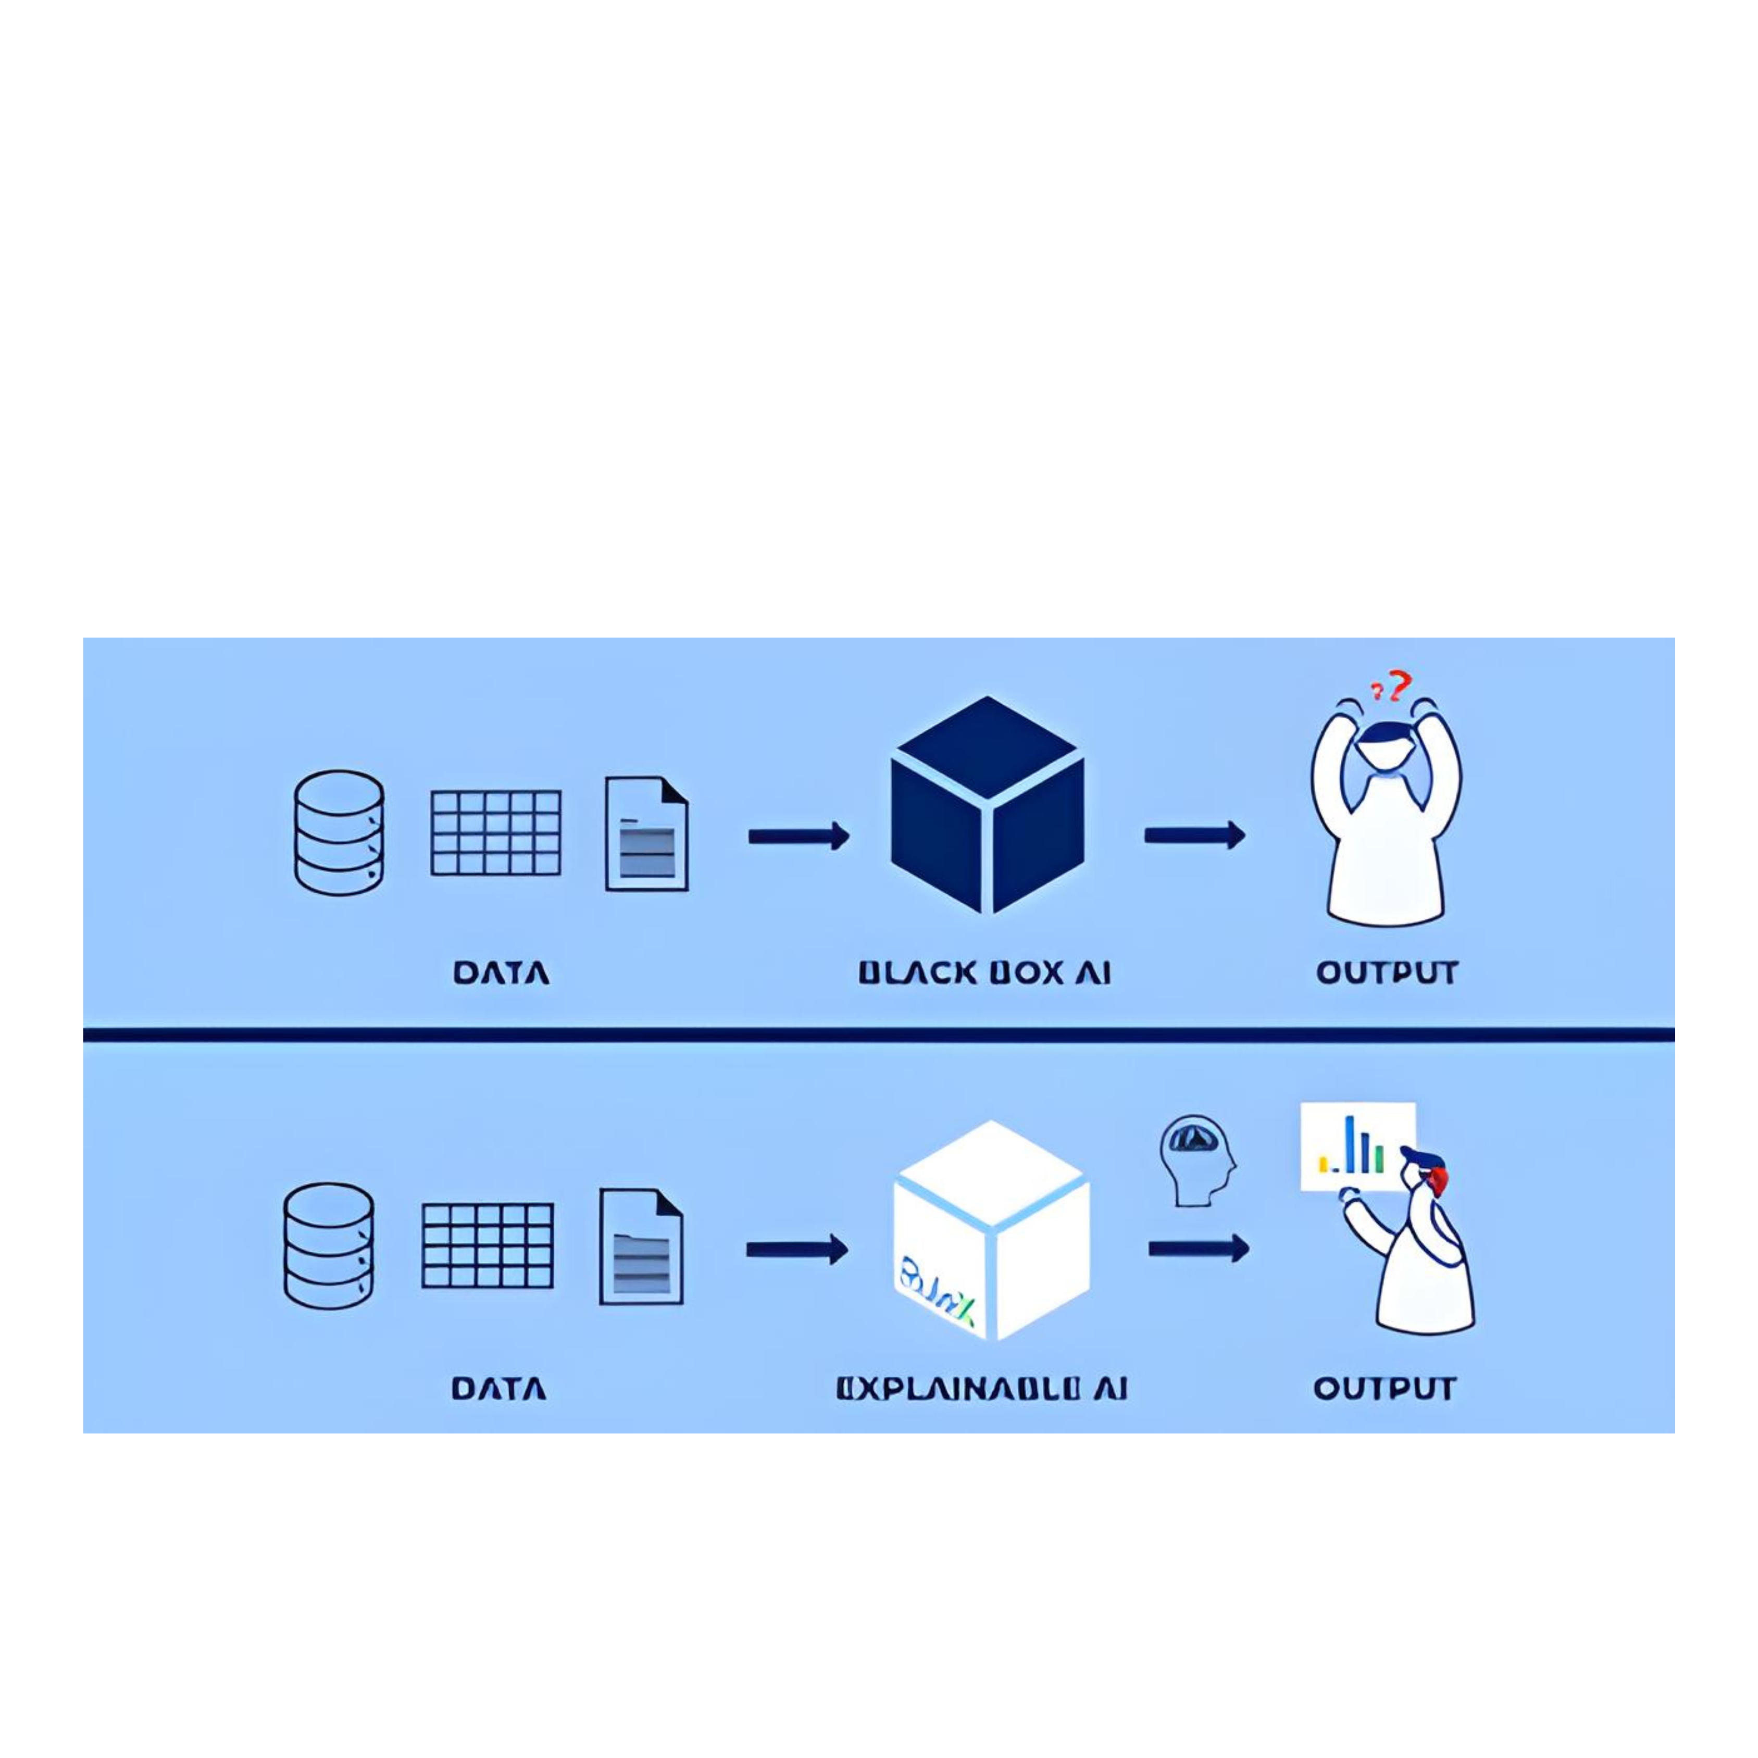
What Is Explanable AI?
XAI helps us understand how AI makes decisions

Slide 5
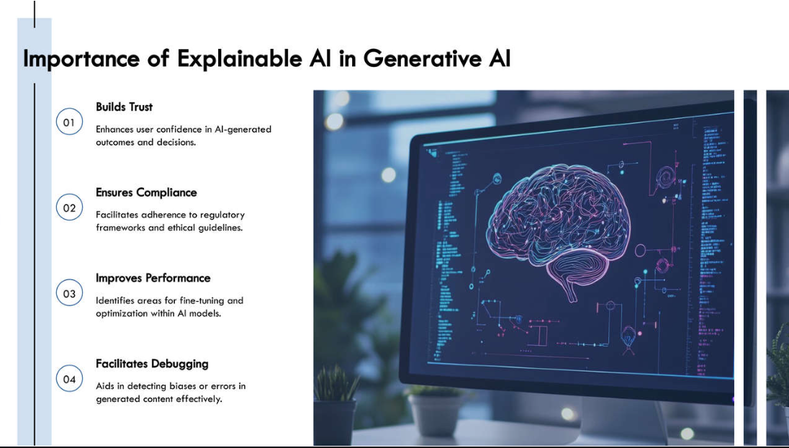
How Does XAI Work in Generative AI?
Transparency Tools
Interpretability
Feedback Loops
Interpretability in XAI means understanding what parts of the input data (images, text, sounds, etc.) the AI model focused on to create the output
Transparency tools provide easy-to-understand explanations of AI’s decisions using visuals, summaries, or interactive breakdowns of its processes
Feedback loops allow developers to refine the AI model based on insights from XAI. These insights help detect biases or errors, which can then be adjusted by fine-tuning the AI model.

Slide 6
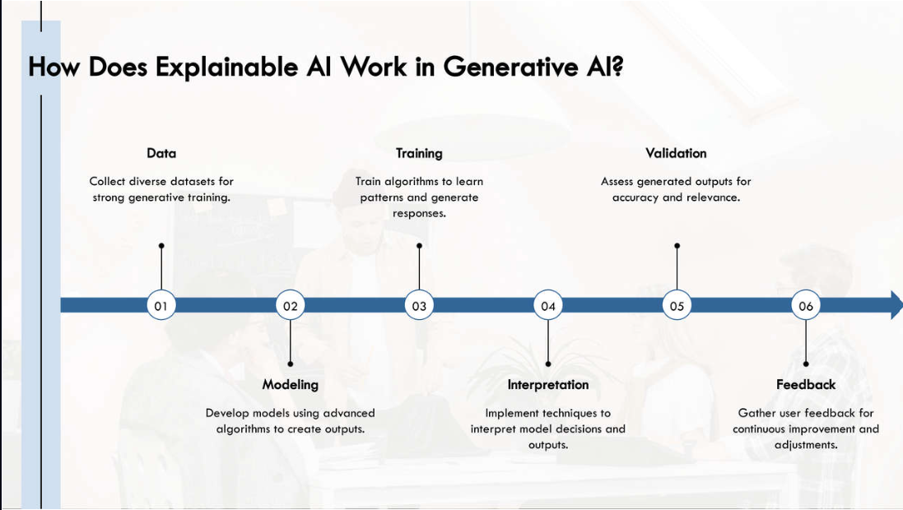

Slide 7
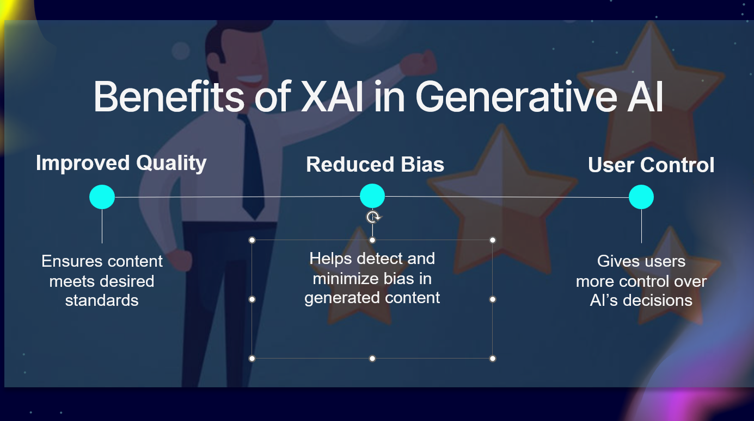
Benefits of XAI in Generative AI
Improved Quality
Reduced Bias
User Control
Ensures content
meets desired standards
Helps detect and
minimize bias in
generated content
Gives users
more control over
AI’s decisions

Slide 8
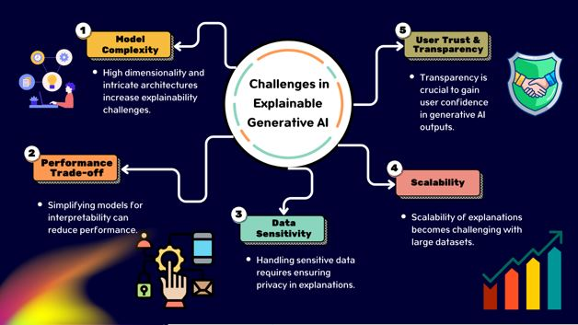
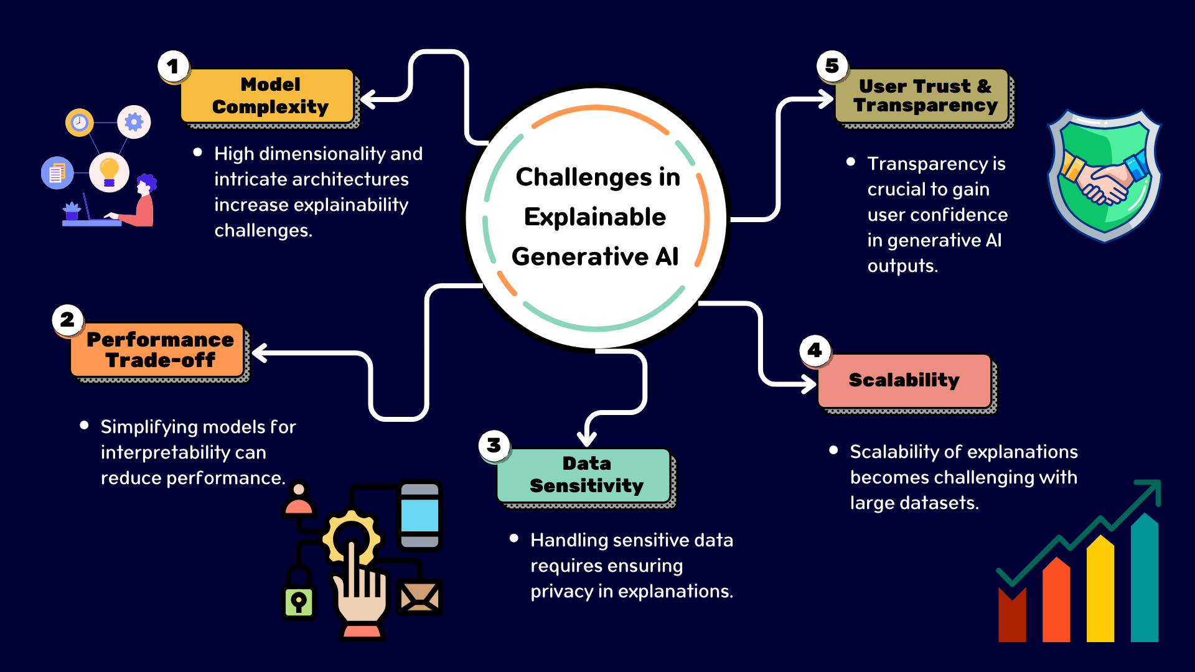

Slide 9
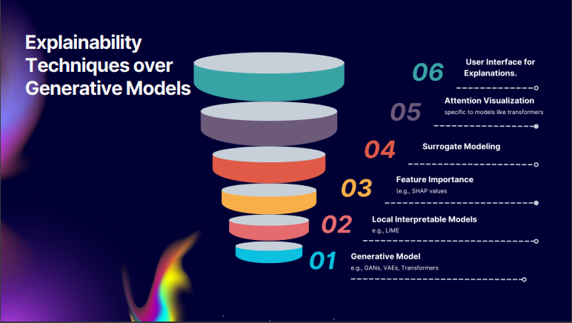
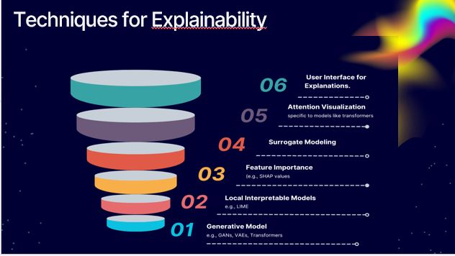

Slide 10
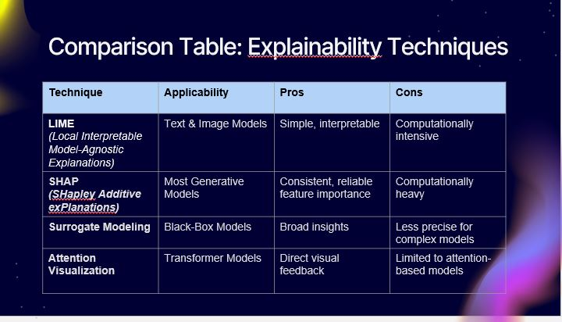
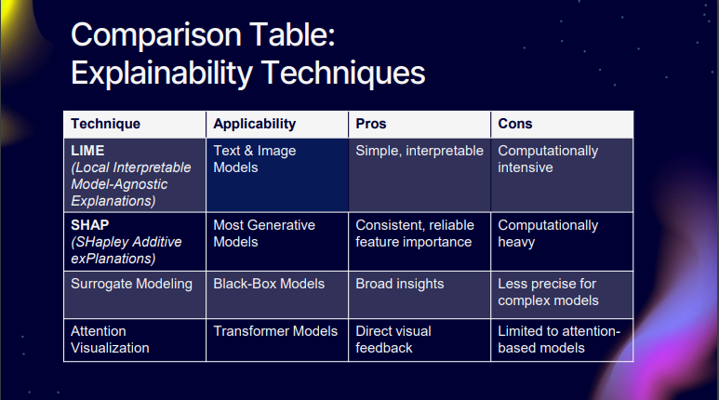

Slide 11
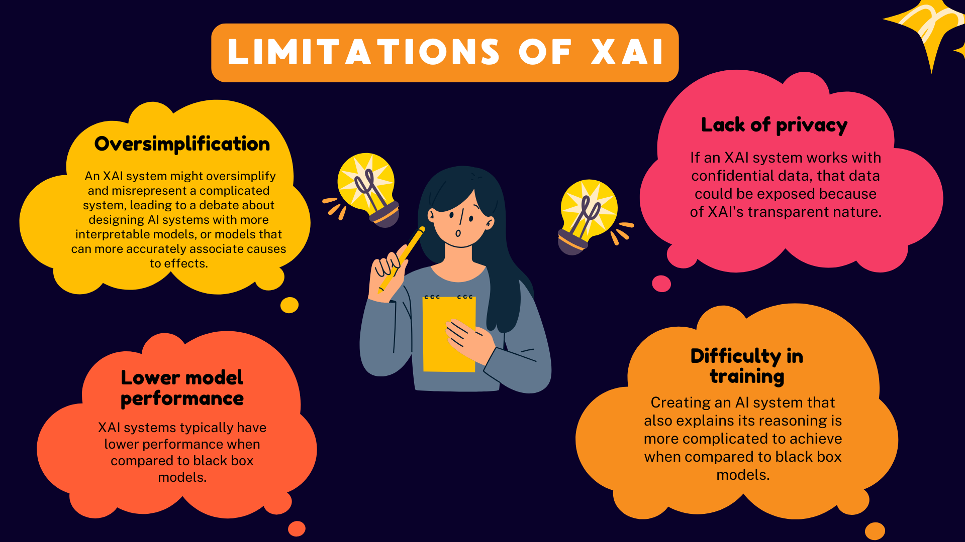

Slide 12
